Slide 1
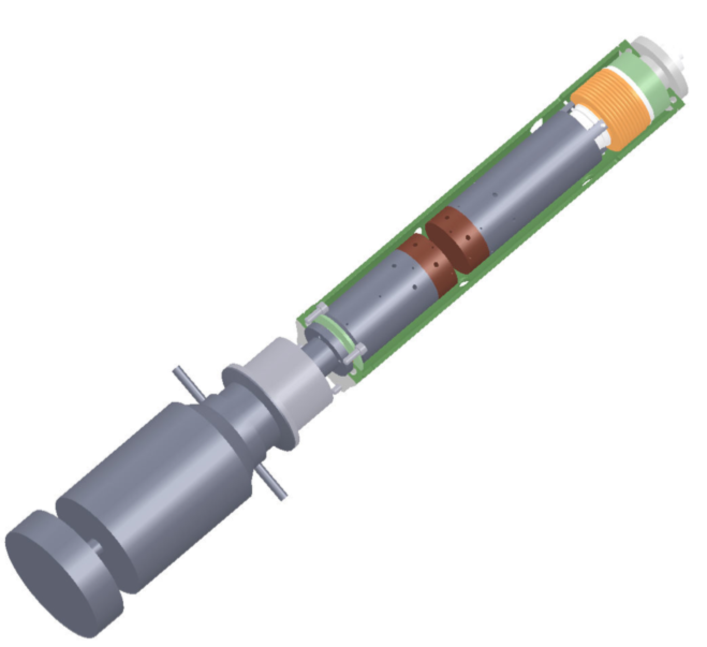


Thermal Conductivity Characterization for Cryogenic Applications
Tareq Alosh
The Catholic University of America
Department of Mechanical Engineering
NASA Goddard Space Flight Center
Thermal Engineering (Code 545)
Nanotechnology Lab

Slide 2
Energy balance

Slide 3
Energy balance
where:
assuming uniform radial temperature
and
Note: Testing is performed under high vacuum, no convective heat transfer

Slide 4
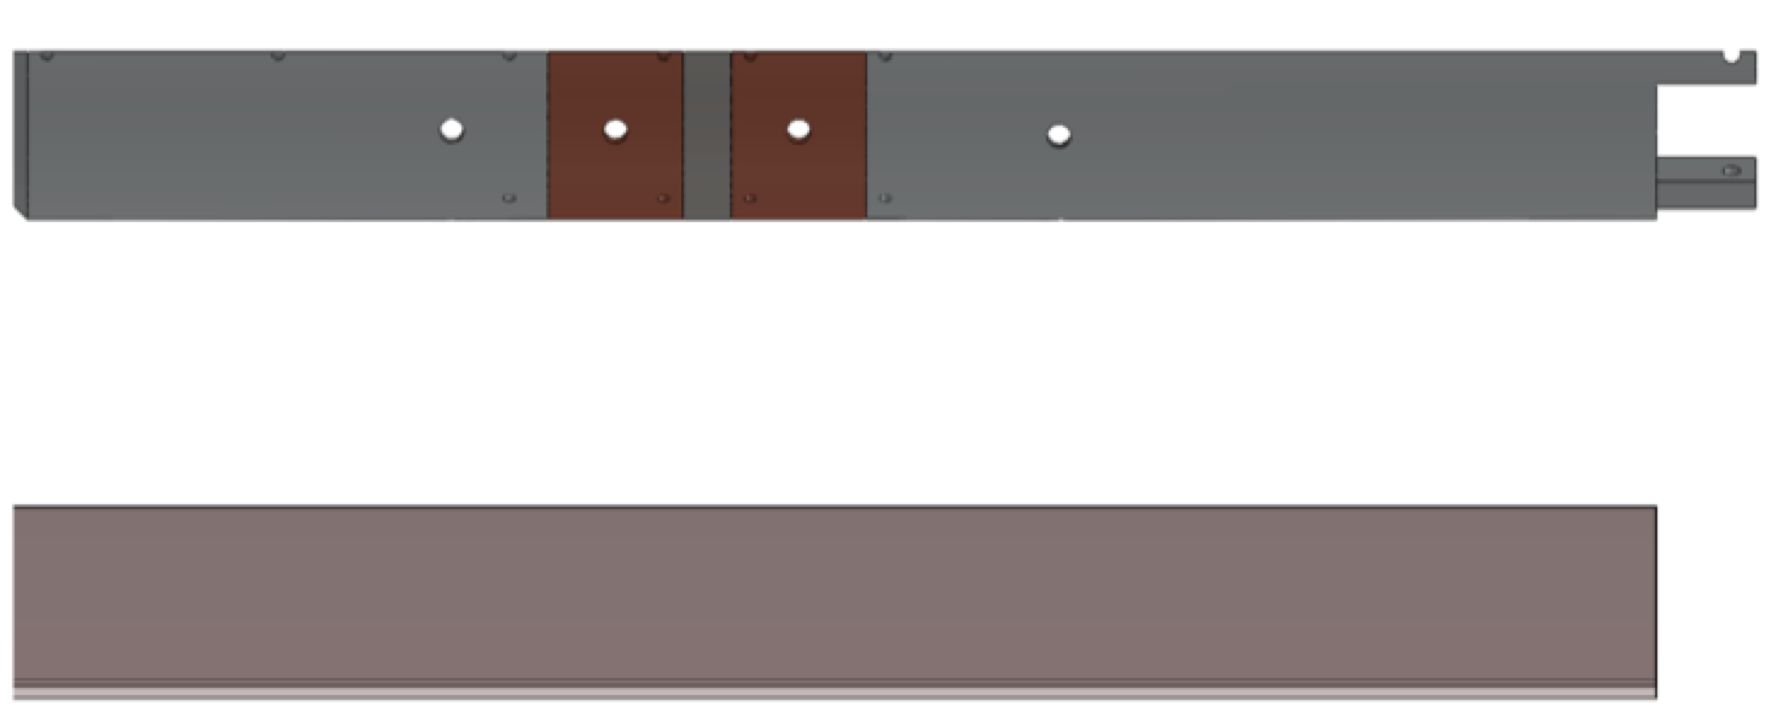
Thermal network
Isothermal

Slide 5
Original facility
Heat losses of up to 50%
Issues with instrumentation in measuring conduction
Inadequate design of radiation shielding
Lateral shifting of meter bars during testing
May be due to improper instrumentation as well as improper use of bellows pressurization system

Slide 6
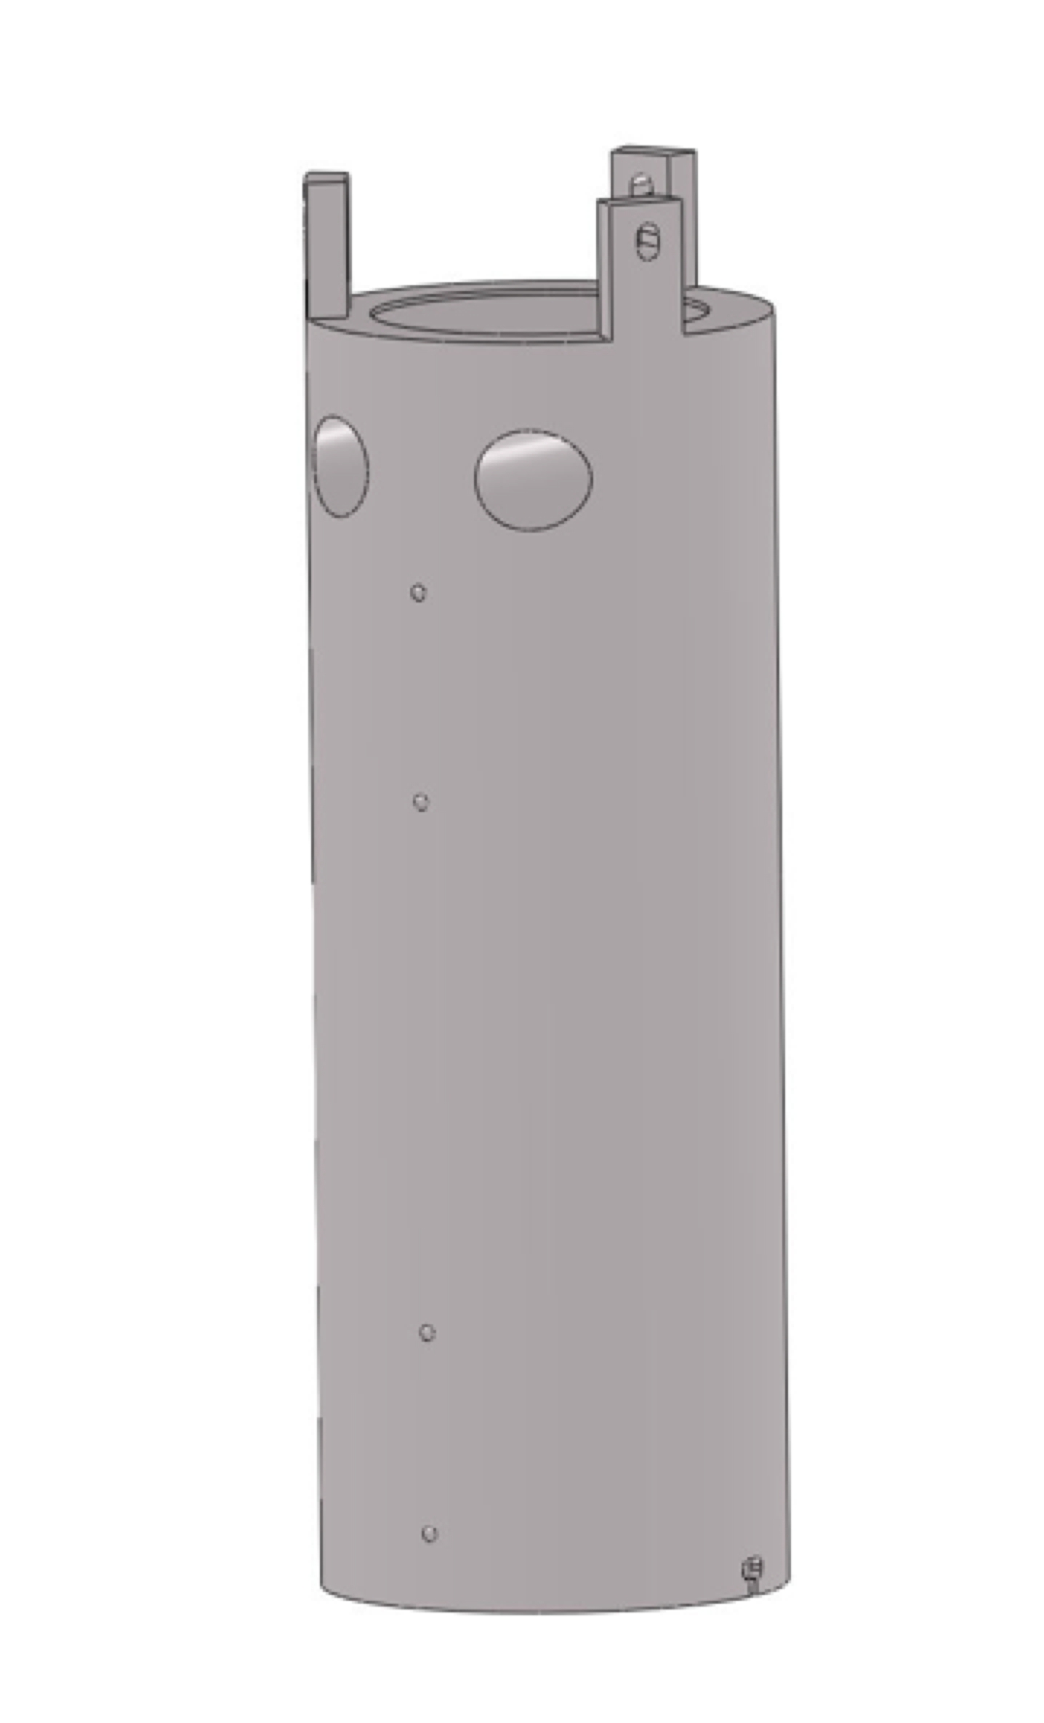
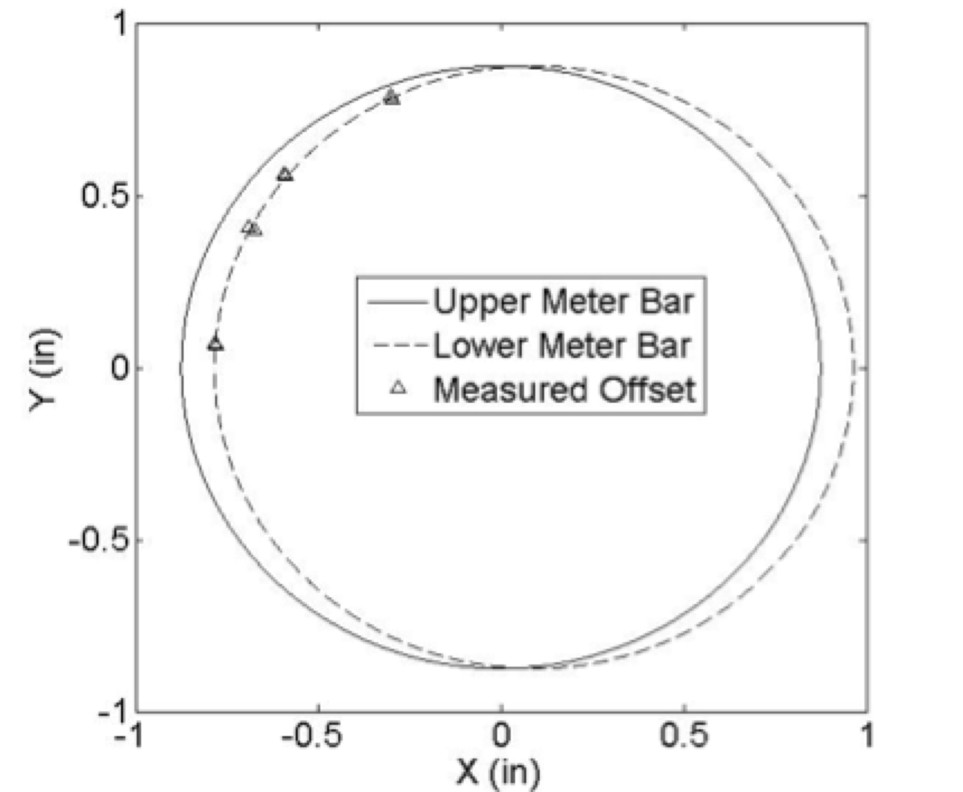
PRTs are located closer to surface of
meter bar and the assumption of
radially uniform temperature is
invalid given lateral shifting
Actual heat transfer (in the
normal direction) is located
within the intersected area and PRTs do not provide valid
data. This may be one reason
contractor was unable to fully
account for heat flows

Slide 7
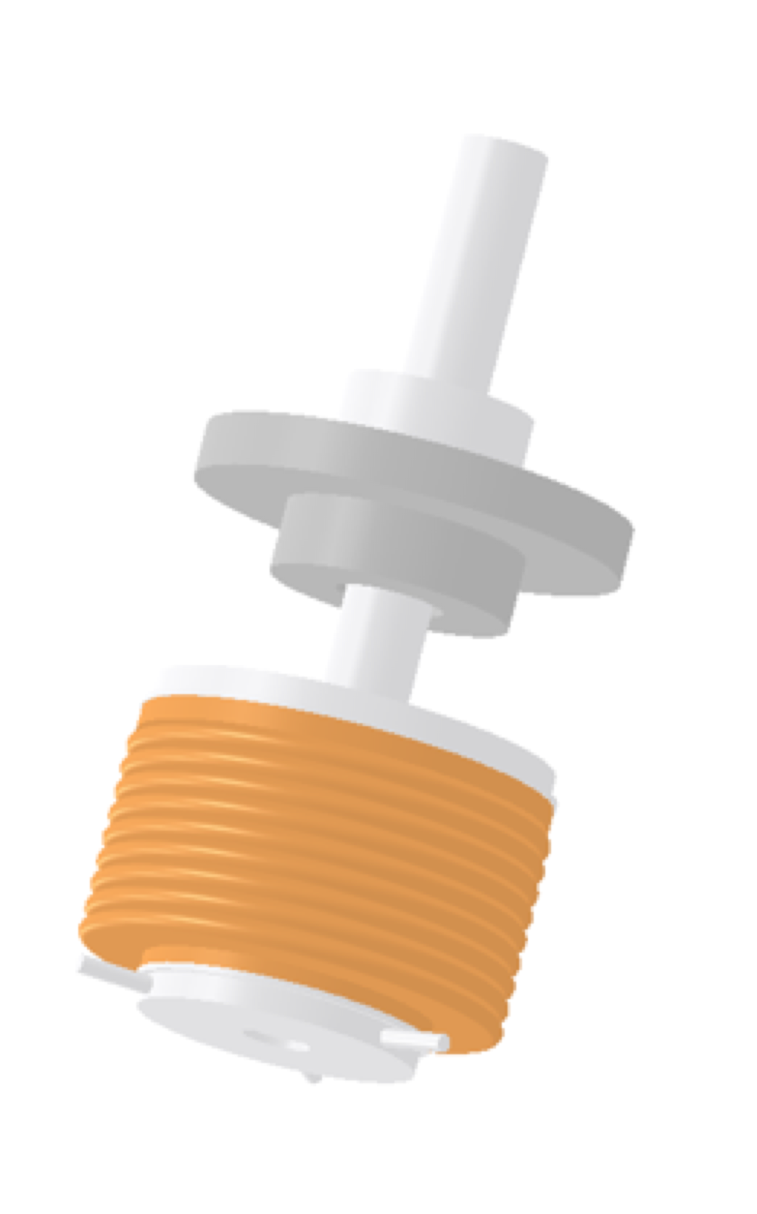
Proposed modifications
The bellows pressurization system currently
uses redirected air from the evacuation of the
testing chamber.
The air is cooled to the cryogenic regime, and
condenses. This causes a decrease in pressure
and thereby contact between sample and
meter bars. It may also damage the bellows
system.
An independent helium system will be used
and pressure on the meter bar system will be
set by a pressure regulator. This will eliminate
the load cell currently used to determine
contact pressure, which is only accurate to a
minimum temperature of - 50°C.

Slide 8
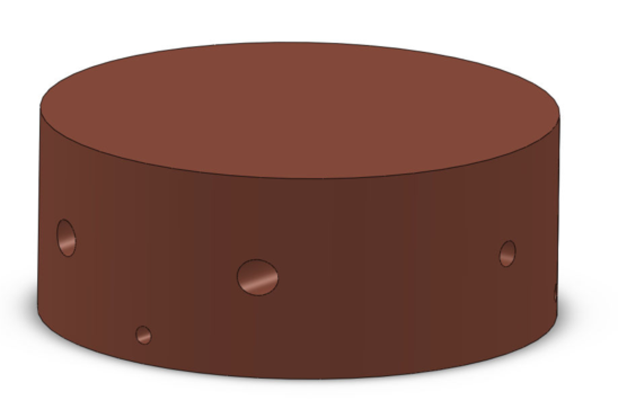
Proposed modifications
Meter bars have been redesigned to use pure
copper with an array of PRTs that will provide
an accurate temperature distribution
throughout cross-sectional area.
Two holes have been designed
perpendicular to the centerline of the cross-
section to accommodate heater
cartridges. Taps have been designed to hold
heater cartridges flush and maintain internal
contact to copper meter bar.

Slide 9
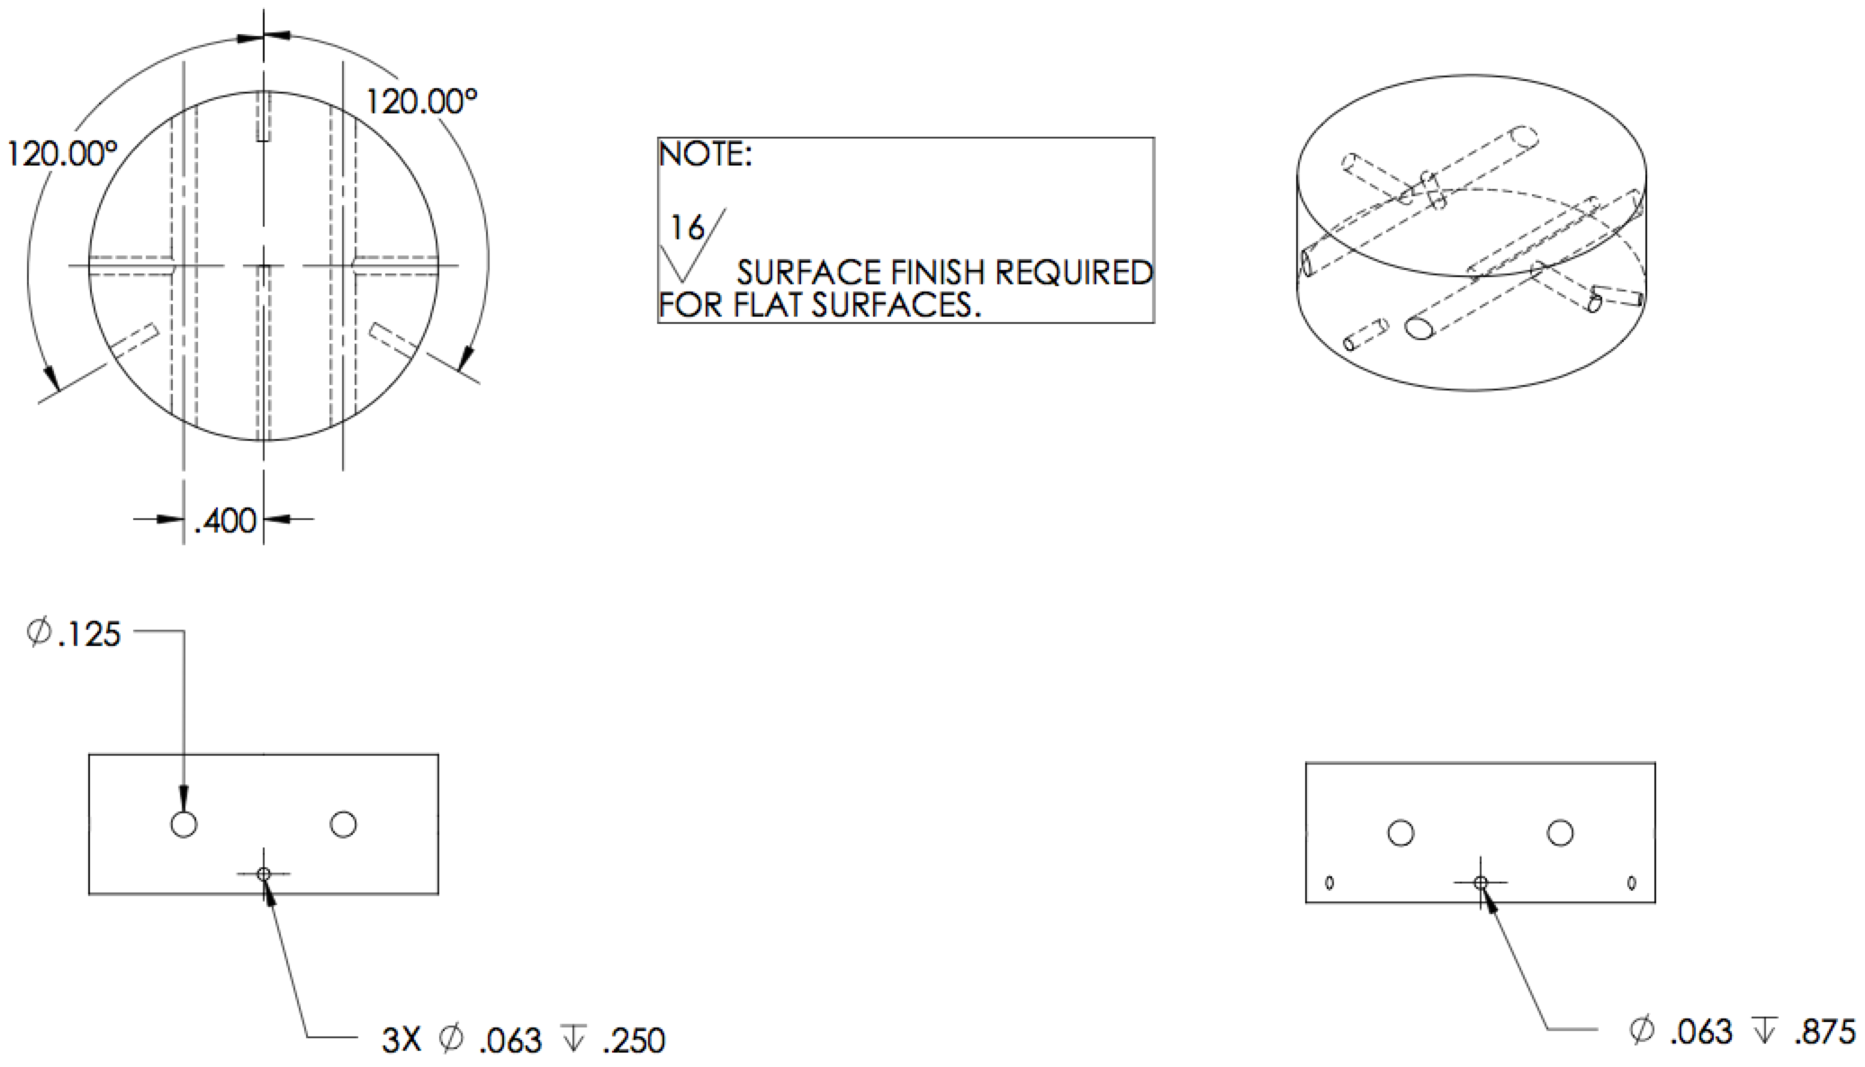

Slide 10
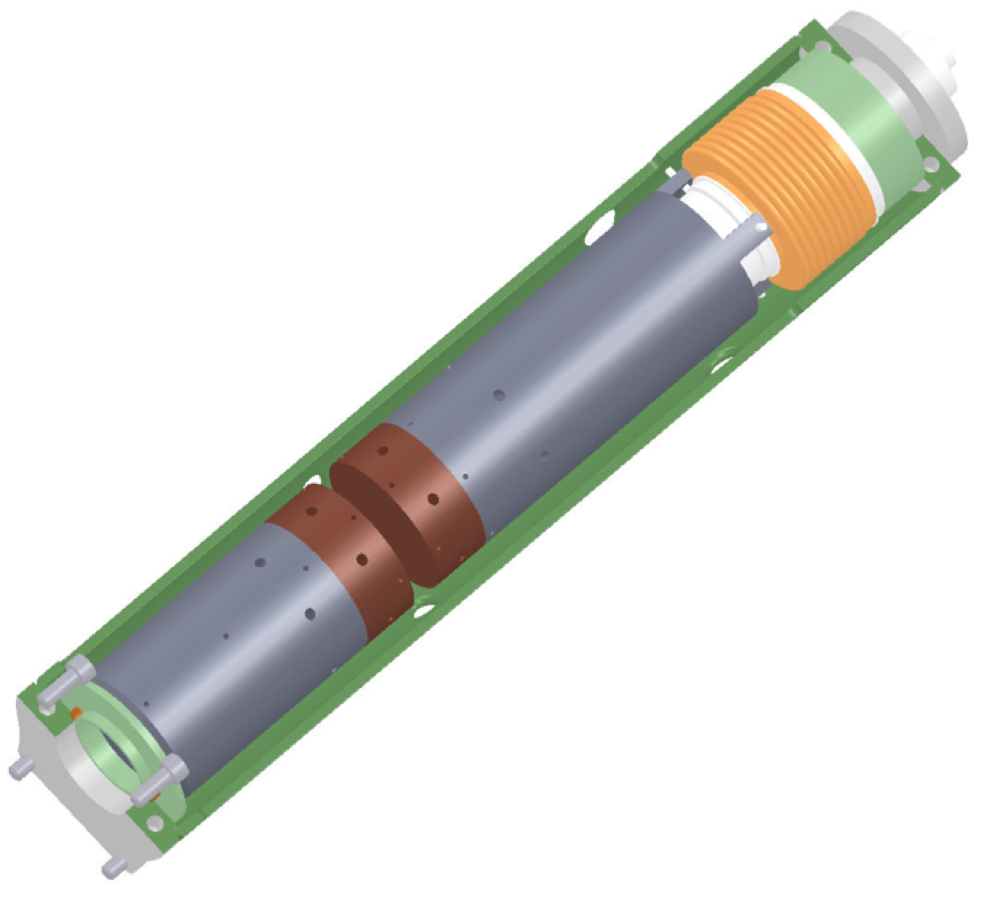
Heat flow metering assembly
Fitting to independently
regulated helium dewar
Hot end
meter bar
Test specimen
location
Cold end
meter bar
Bellows system
(2X) Copper
meter bars

Slide 11
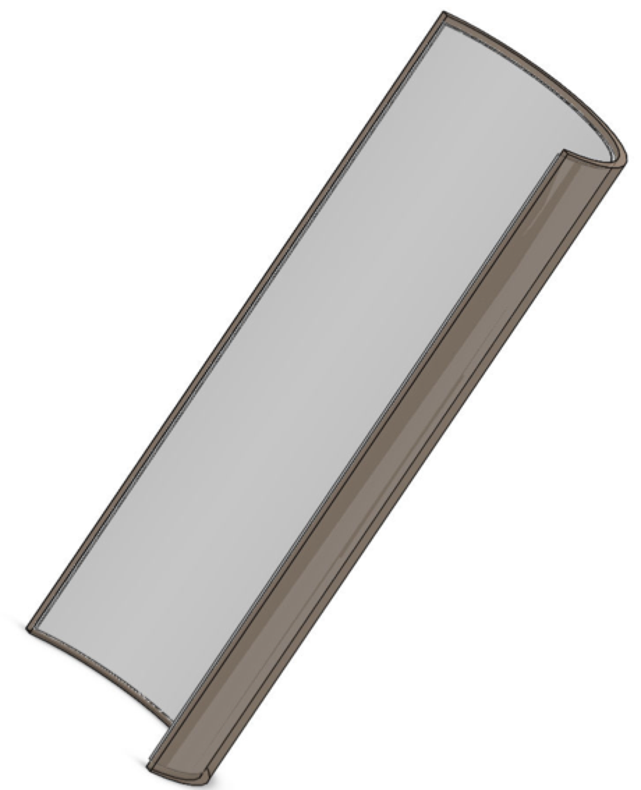
Thermal radiation considerations
Unwanted heat transfer may be due (partially) to radiation effects
Radiation shielding should be constructed of low conductivity materials to create isothermal conditions at any position along shield
Also beneficial in case of incidental contact
Proposed radiation shielding
Outer shell: Ultem [PEI] Tubing
Inner shell: Fiberfrax Insulation Blanket

Slide 12
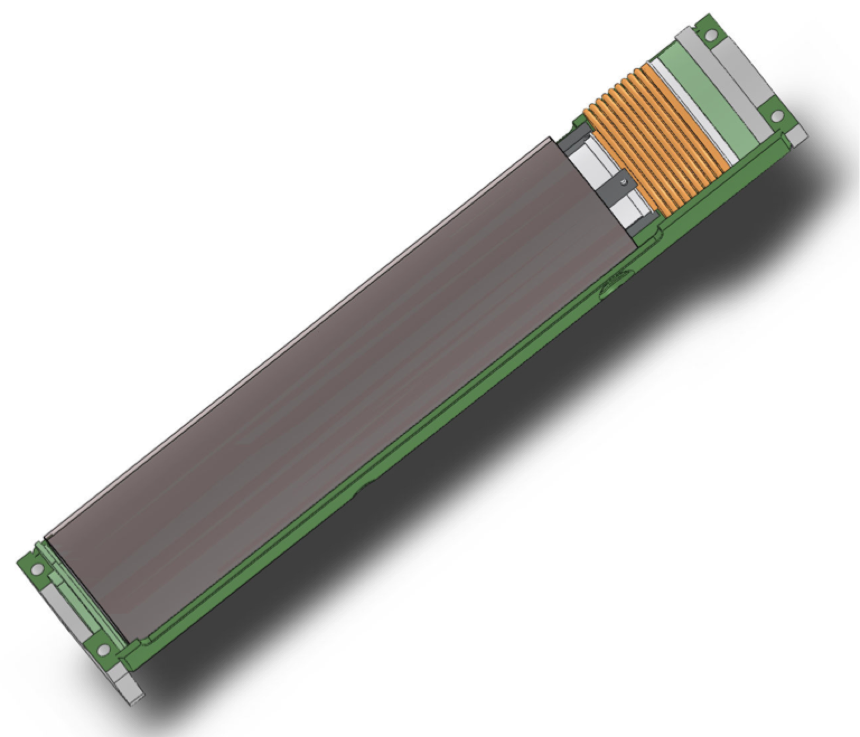
Radiation shield assembly

Slide 13
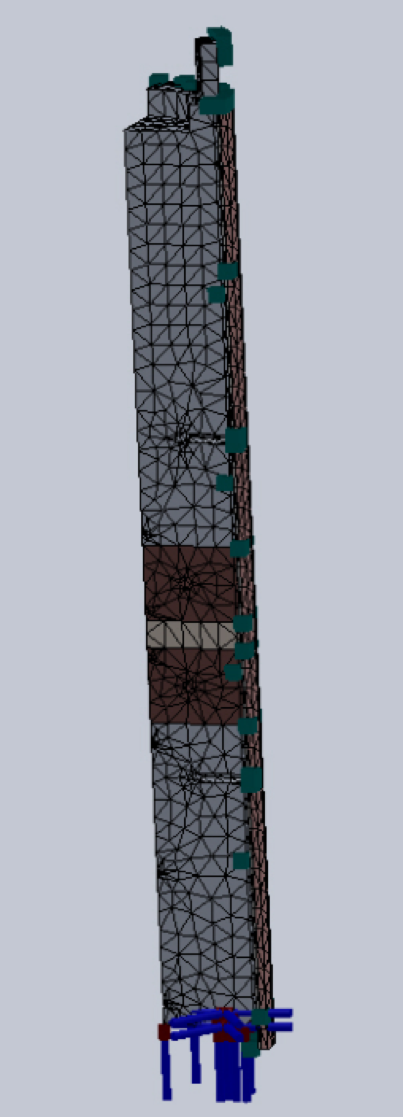
Anticipated effects (using FEA)
With small temperature differences, the radiation shielding achieves a constant temperature
Radiation heat transfer becomes negligible in terms of heating load on cryocooler
PID control of hot end meter bar will maintain proper temperatures
Cryocooler is able to maintain a cold end temperature of 70 K

Slide 14
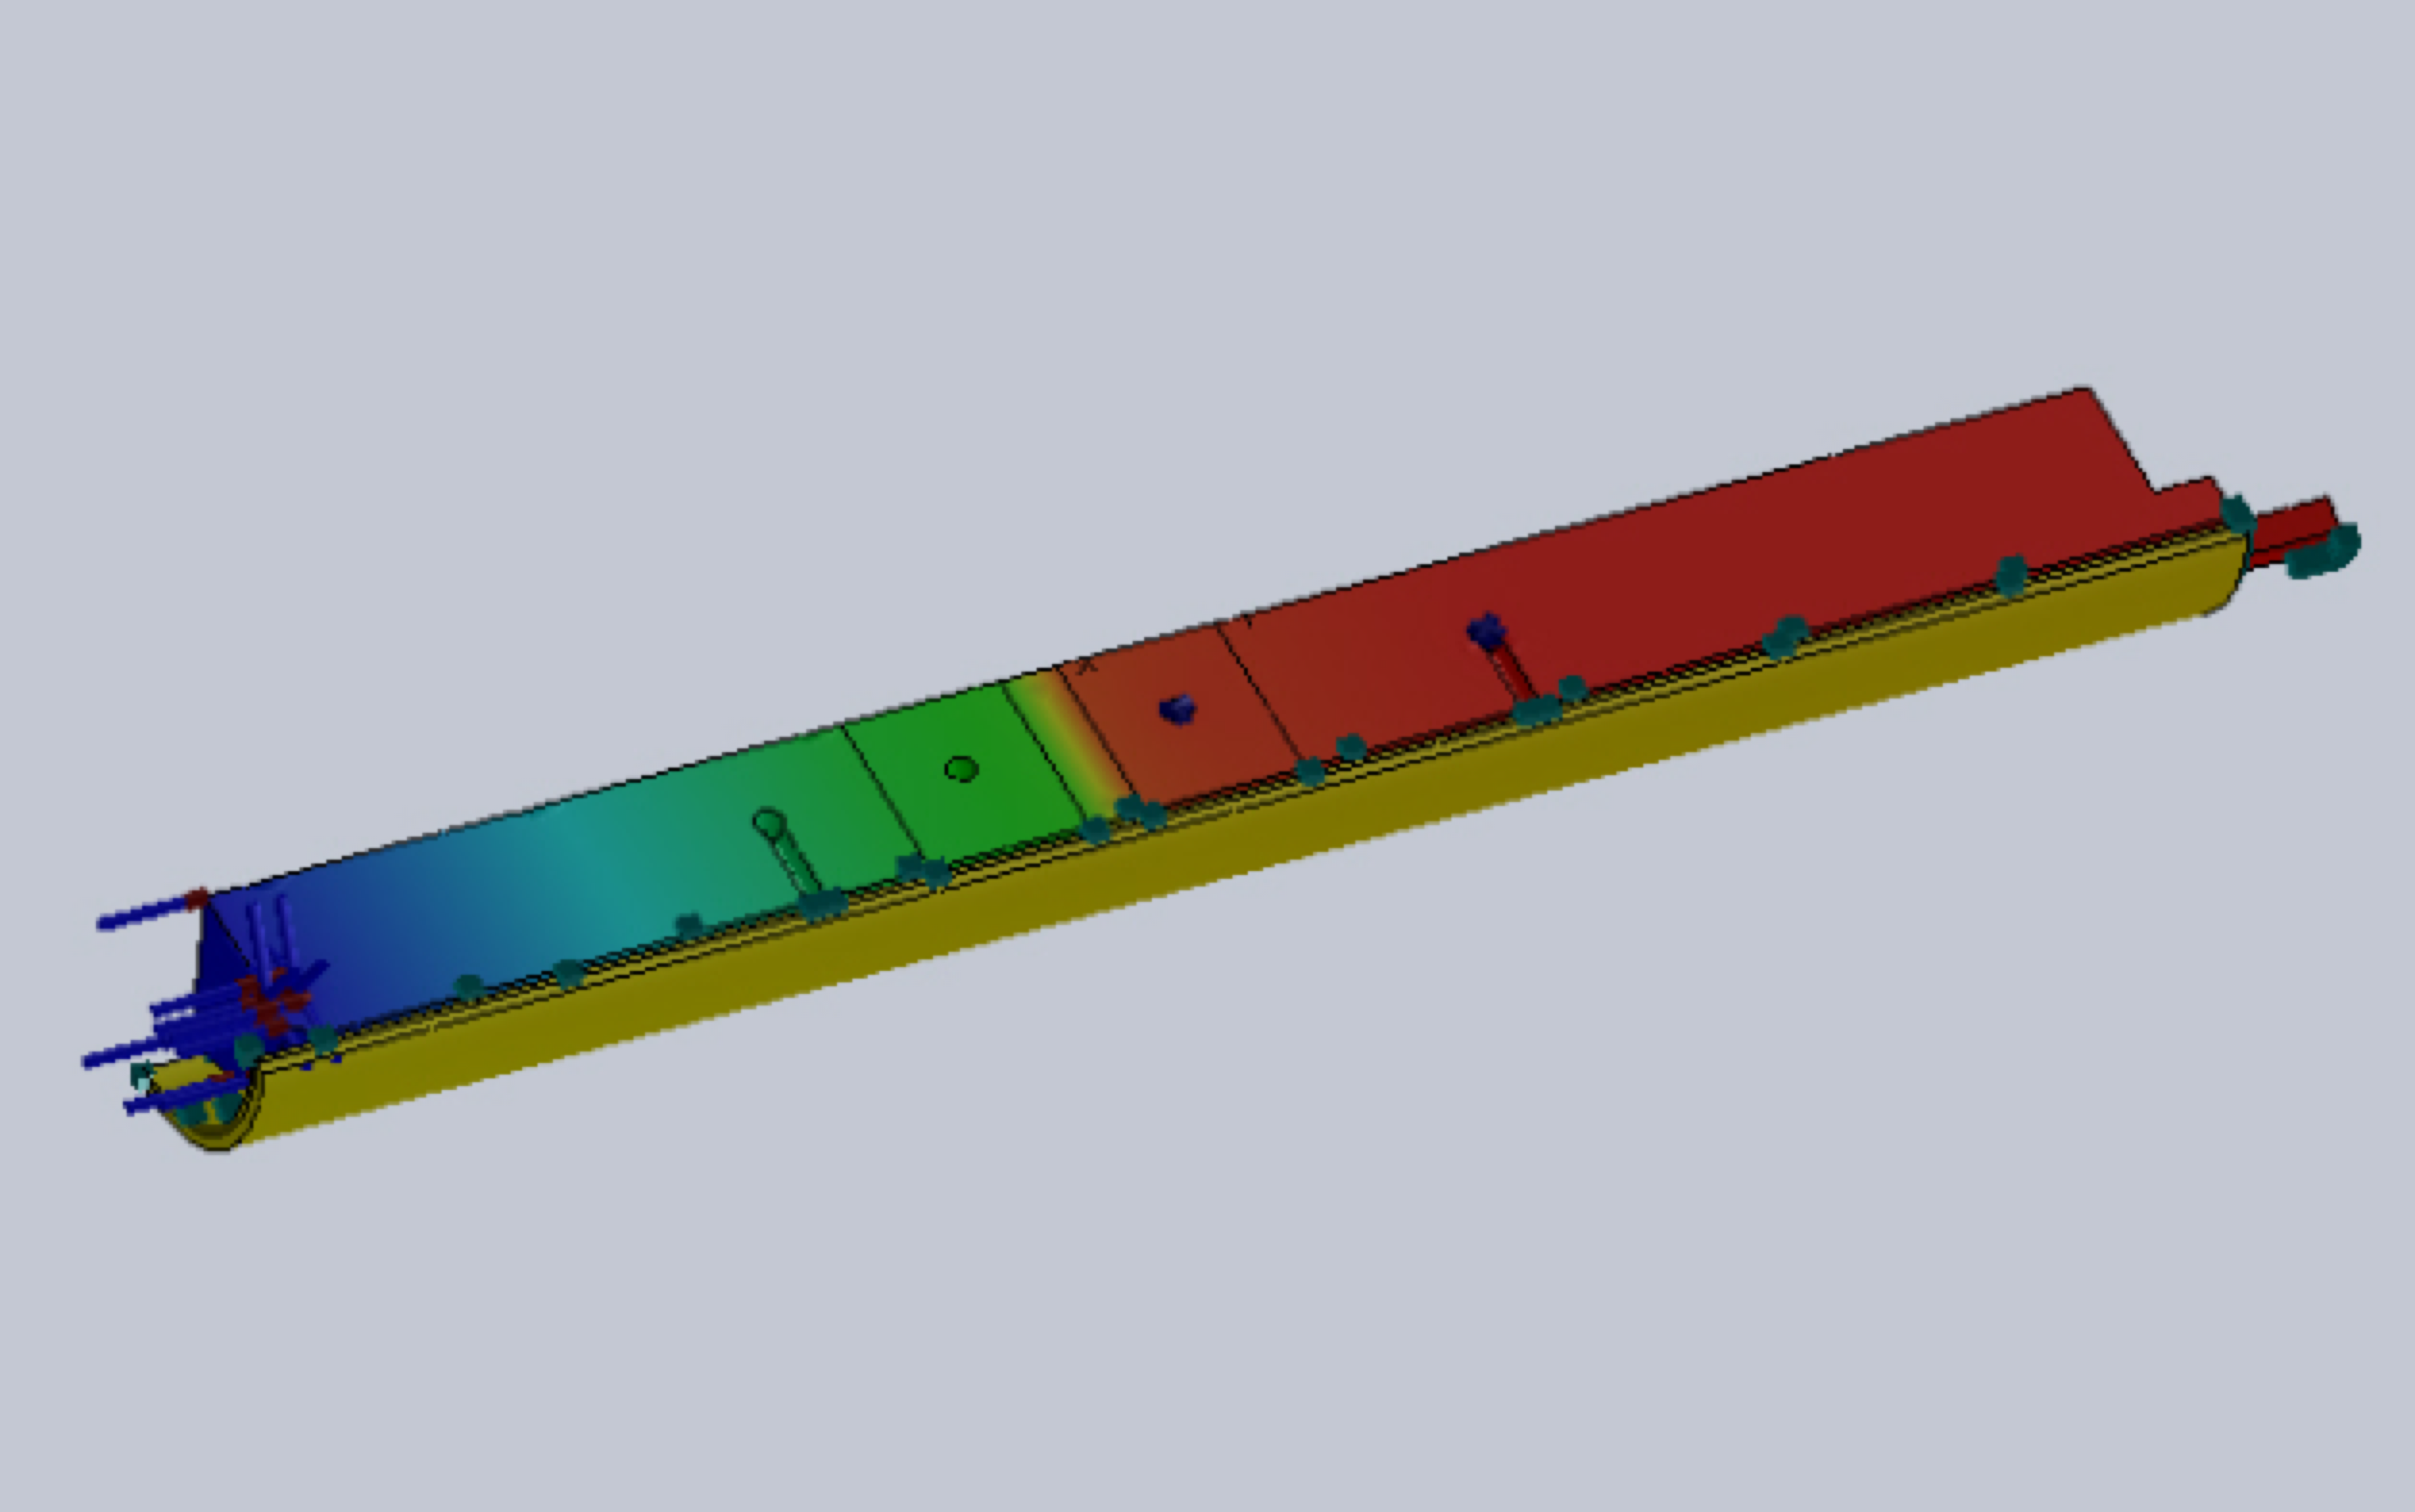
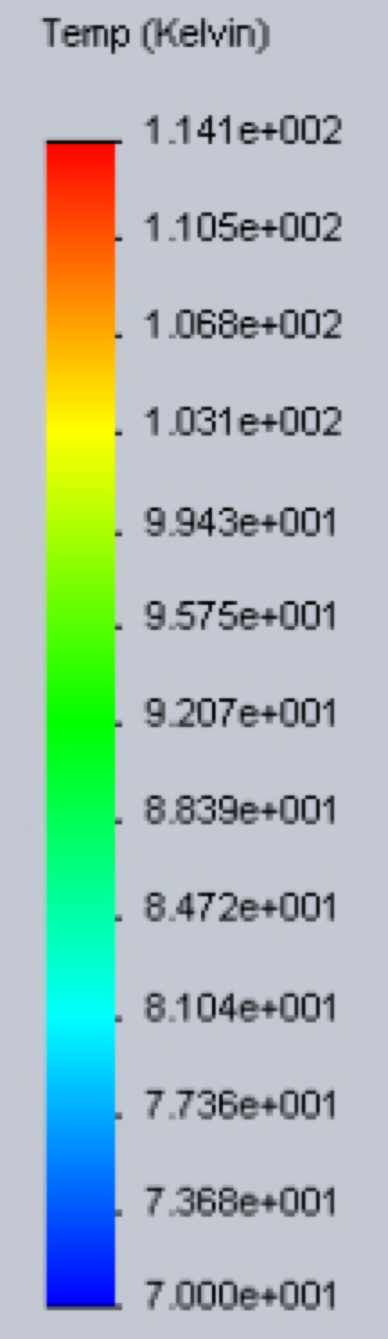
Small temperature differences (realistic testing conditions: ΔT ≈ 40 K)

Slide 15
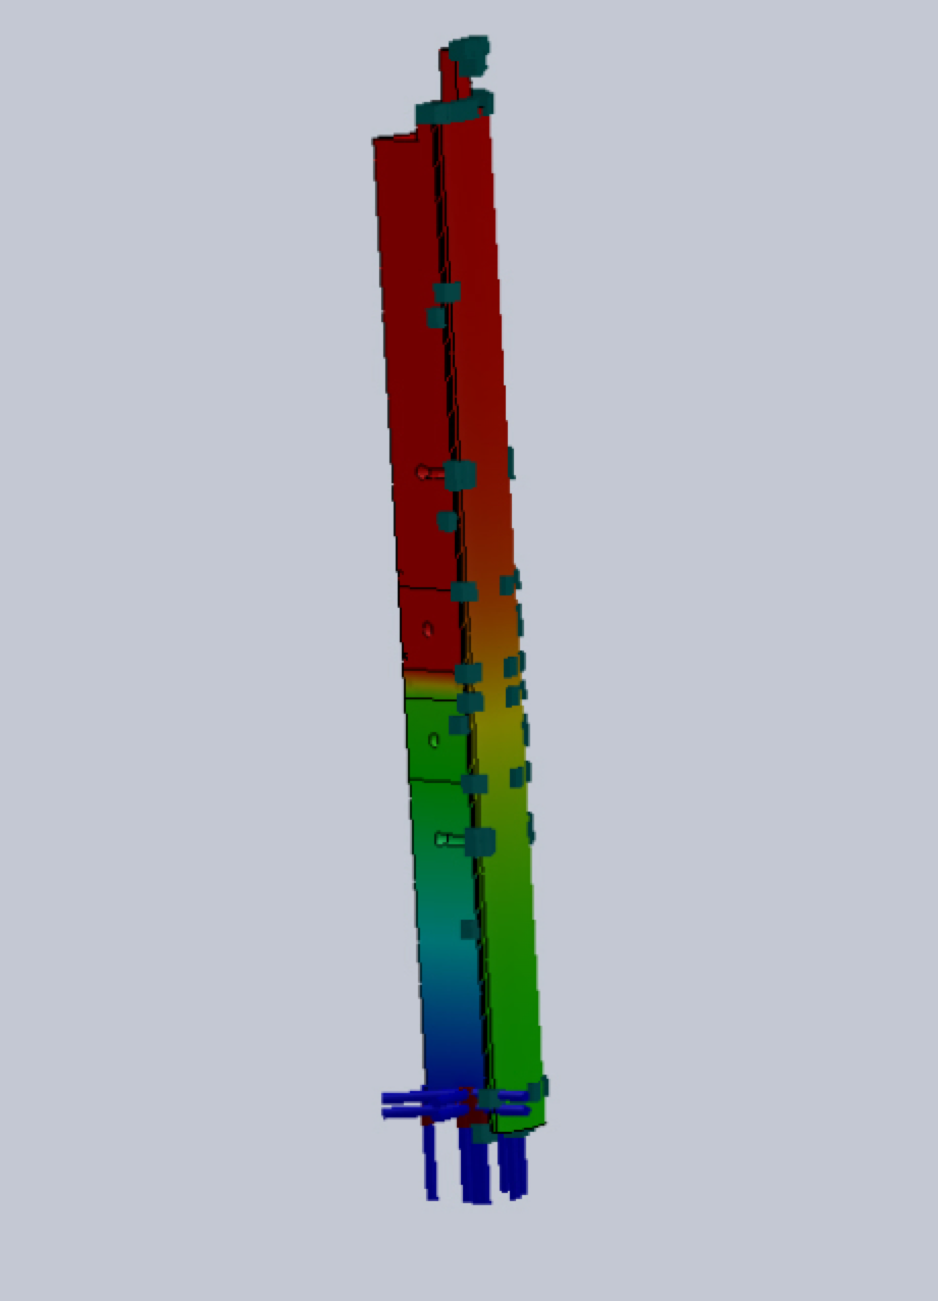
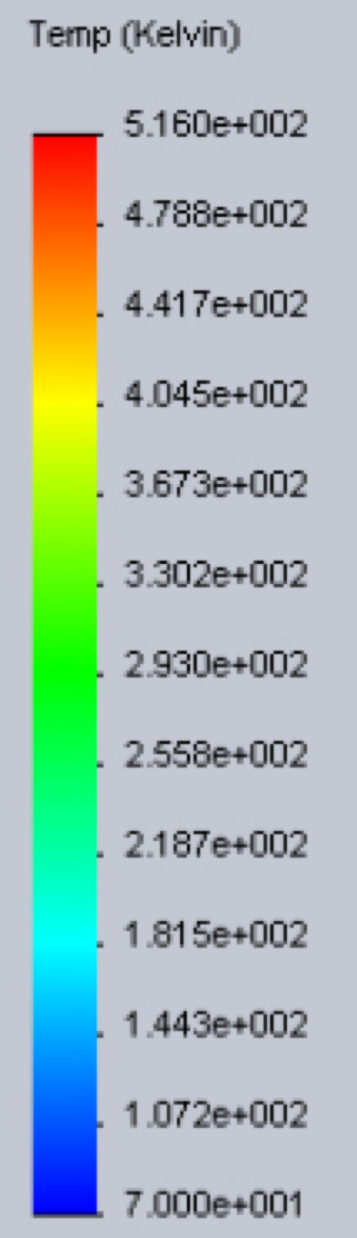
Large temperature differences (operational limits: ΔT ≈ 450 K)

Slide 16
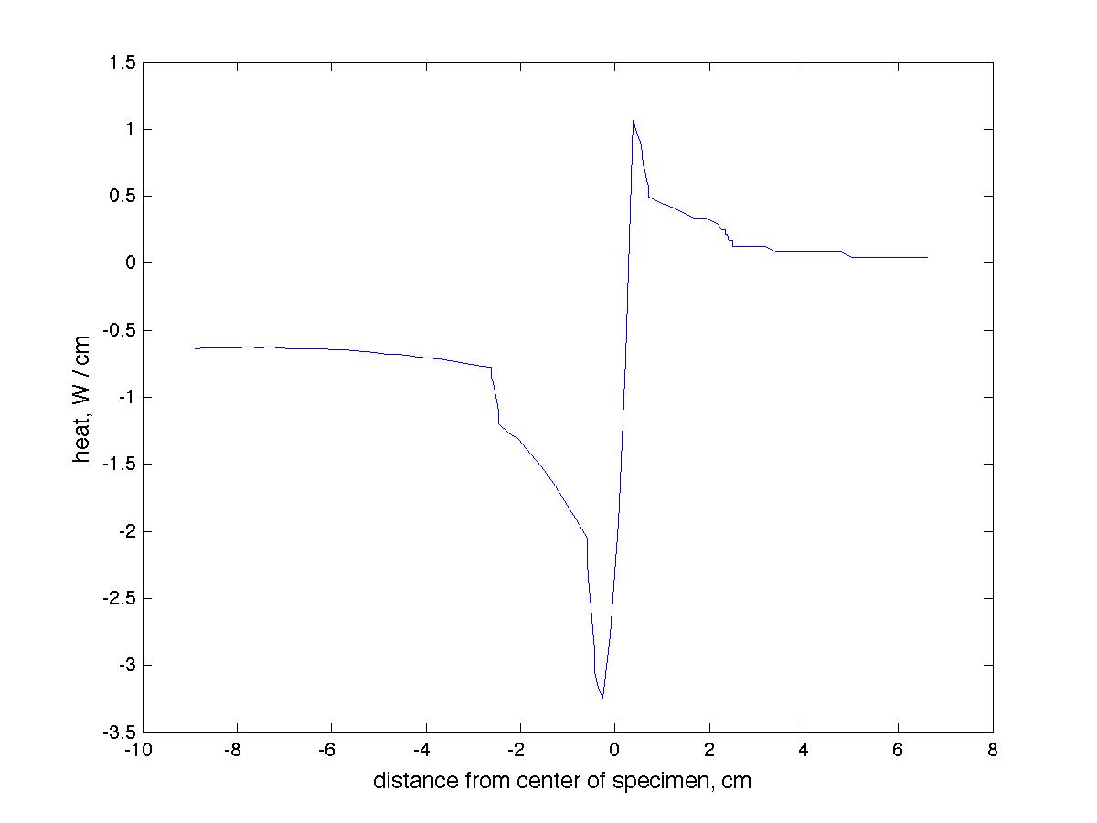
Radiation heat load on meter bars (at operational limits)

Slide 17
Preliminary radiation analysis
To achieve maximum temperature difference in meter bars (ΔT ≈ 450 K), 566 W is needed from cartridge heaters
This is a theoretical amount of heat used as a worst case scenario for radiation analysis
Parasitic heat transfer due to radiation is a roughly 8 W gain

Slide 18
Acknowledgements
Jeff Didion
NASA GSFC: Senior Thermal Engineer/Mentor
Mario Martins
Edge Space Systems: Thermal Laboratory Manager
Mark Kobel
NASA GSFC: Senior Thermal Engineer
Frank Robinson
NASA GSFC: Thermal Engineering Co-op
Elizabeth Hadley and David Jovel
NASA GSFC: Thermal Engineering Interns
Everyone in Code 545

